Slide 1
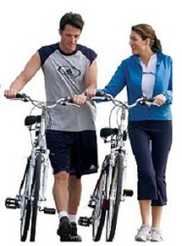
Johnny D’s Health Zone Plus
“The Healthy Choice for Healthy Lifestyles”
Sports Nutrition,
Weight Management,
Vitamins & Supplements,
Skin Care & Cosmetics,
& Eco-Friendly Cleaning Products
Independent Business Owner
John K. Doherty
Southwest Florida Region
January 2019

Slide 2
Table of Contents
Slide No.
Company Background ………………………..... 3-4
Product List …………………………………..... 5
Energy Drink ……………………………............ 6-10
Sports Nutrition ……………………………….. 11
Vitamins & Supplements ………………………. 12-17
Weight Management …………………………… 18-19
Skin Care ………………………………………. 20-25
Cosmetics ……………………………………… 26-28
Eco-Friendly Cleaning Supplies ……………….... 29
Fun Facts ………………………………………. 30
The Opportunity ……………………………….. 31
Top Business Trends …………………………… 32
Company YouTube Videos ……………………... 33-35
Business Opportunity Survey …………………… 36
Contact Information …………………………… 37

Slide 3
About the Company
Health Zone Plus is an independent business and a representative of Amway Global.
Amway Global is a direct selling company within the Health & Beauty (Wellness) industry.
The “Health Zone Plus” name was chosen by THIS individual business owner and is NOT part of Amway Global.
Health Zone Plus only sells Amway products through
our personal online store or face-to-face.

Slide 4

About Amway
Amway started in Michigan, USA in 1959
Currently in over 100 countries & territories
Recognized as a leader in the direct selling & networking marketing industries
Member of the Better Business Bureau
Compensation Plan approved by the FTC
#1 online health & beauty retailer (since 2002)
Founders of Amway own the NBA team the Orlando Magic

Slide 5






Amway Exclusive Product Lines
Vitamins & Supplements
Skin Care & Cosmetics
Weight Management
Eco-Friendly Household Cleaning Products
(formerly Legacy of Clean)

Slide 6


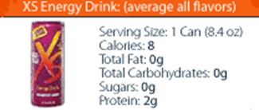
The Products – XS Energy Drink
XS Energy Drinks contains no sugar, no carbohydrates, and just 8 calories - while delivering a powerful punch of B vitamins.
Premium Energy ~ Explosive Taste

Slide 7

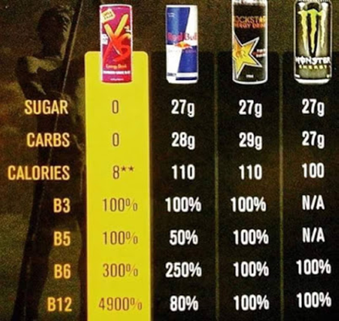
XS Energy Drink
Boost your mental and physical energy without the high levels of sugar, carbs, and calories found in other energy drinks.
XS Energy Drinks VS. Other Energy Drinks

Slide 8

Health Benefits of XS Energy
XS Energy Drinks have ingredients that can...
- Increase Metabolism
- Lower Cholesterol
- Help with Diabetes
- Enhance Immune System
- Help body deal with stress
XS is much more than just an energy drink...
it is really a "health" drink.

Slide 9
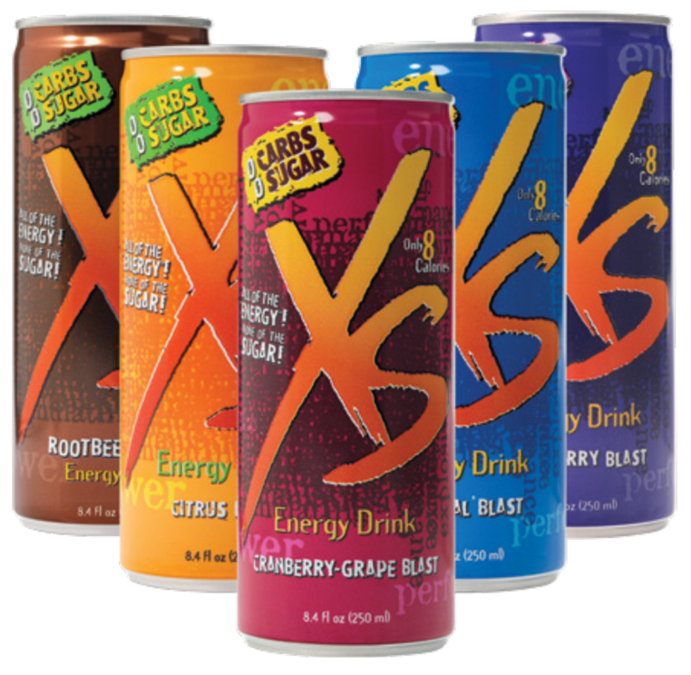
XS Energy Drink – The Flavors
Tropical ● Citrus ● Wild Berry
Cranberry-Grape ● Electric Lemon
Rootbeer ● Black Cherry Cola
8.4 oz. can (Sold in cases of 12 cans)
Also available:
Sparking Juice Flavors:
Mango-Pineapple-Guava,
Pink Grapefruit & Dragon Fruit
Energy + Burn Flavors:
Orange & Strawberry
Caffeine-free Flavors:
Cranberry-Grape &
Mango-Pineapple-Guava

Slide 10


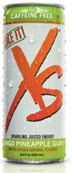

XS Energy Drink – Sparkling Juices

Slide 11


XS Sports Nutrition
Introducing
XS™ Sports Nutrition
www.youtube.com/watch?v=M62HqkN2_iY

Slide 12



NUTRILITE Vitamins & Supplements
Nutrilite History: A Timeline of 80 Years of Growth
www.youtube.com/watch?v=ViX52XromEE

Slide 13



Vitamins & Supplements
WHY NUTRILITE?
Best of Science. Best of Nature.
www.youtube.com/watch?v=XHQ8S8rOqeU

Slide 14


Vitamins & Supplements
What Supplements Should I Take?
The Nutrilite Foundational Four
www.youtube.com/watch?v=RunzTOggjx8
Nutrilite: Bridging the Nutrition Gap
www.youtube.com/watch?v=vK7-CESFlGw

Slide 15


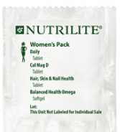
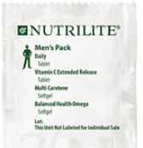
Vitamins & Supplements – Combo Packs

Slide 16
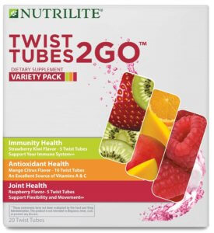


NUTRILITE Twist Tubes:
A refreshing way to get vitamins into your diet while supporting a healthy immune system.
An excellent source of
vitamins A & C
Instructions
Simply twist open a tube and add to at least 16 ounces of water. Squeeze into bottle, then shake or stir to blend and enjoy the delicious flavor and immune health, joint health or antioxidant support benefits. (When opening a new 16oz bottle of water take a sip first then squeeze contents of tube into bottle. )

Slide 17
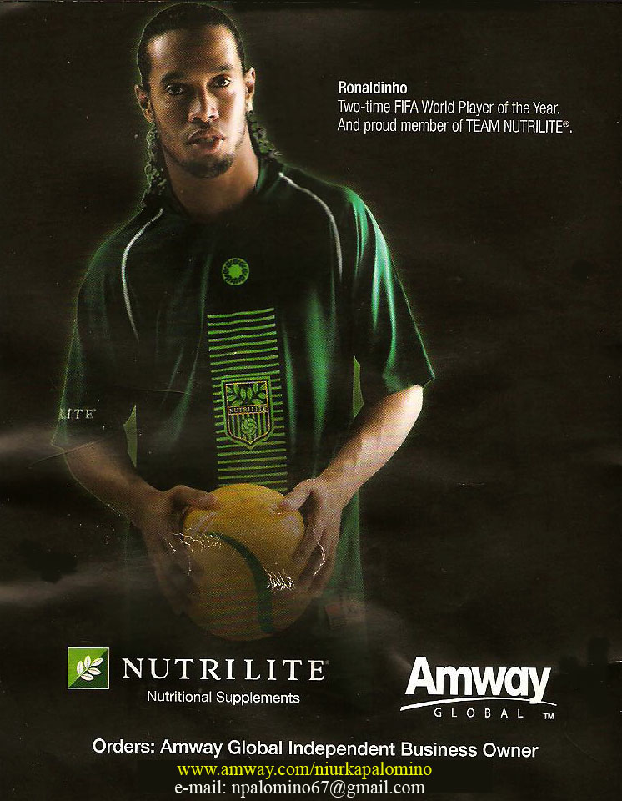

World Athletes Endorse NUTRILITE

Slide 18



NUTRILITE – Weight Management
BodyKey Science Of Weight Loss
www.youtube.com/watch?v=ZKGxfwNuAXY
4 BodyKey Tips for Living a Healthy Lifestyle
www.youtube.com/watch?v=dY03HeYFqaw

Slide 19
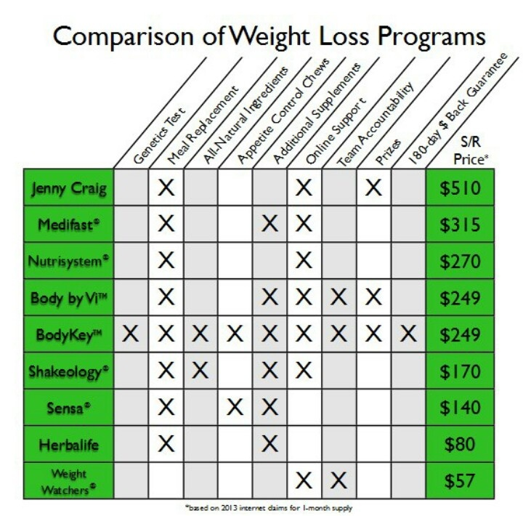
BODYKEY Weight Loss Program
Comparison
Of
Weight Loss
Programs

Slide 20


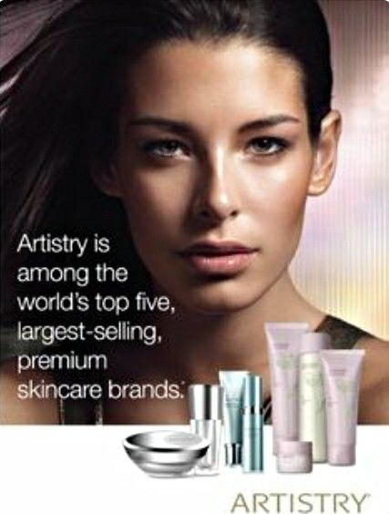

ARTISTRY

Slide 21



ARTISTRY – Skin Care

Slide 22

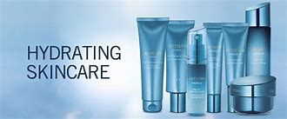

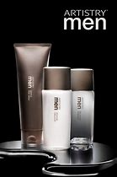

ARTISTRY – Skin Care

Slide 23

ARTISTRY – Celebrity Endorsement

Slide 24
Artistry Skin Care YouTube Videos
Artistry Premium Skincare Forward Beauty
Learn how Artistry is pushing the boundaries of beauty with 3 keys pillars: Discovery, Imagination, and Invention. This is known as Forward Beauty. www.youtube.com/watch?v=LKFK9Ch0BEc
Amway Artistry's Signature Select Personalized Serum | WHQ News
In today’s world of smartphone commerce, it’s more important than ever that the products we sell can be customized to suit the user’s needs. That’s especially true when it comes to beauty and skincare products. www.youtube.com/watch?v=sMTr_ybn_t8
The Artistry Ultimate 10 Minute Facial - Easy Step by Step Instructions
Learn the step by step instructions from Michelle D'Allaird of the simple Artistry 10-minute facial regimen that is so easy, you can do it in the comfort of your own home.
www.youtube.com/watch?v=uWCo0jjO2Qs
Artistry Ideal Radiance
7-Day Challenge Customer Reviews
www.youtube.com/watch?v=x6KcF0aUkKM

Slide 25
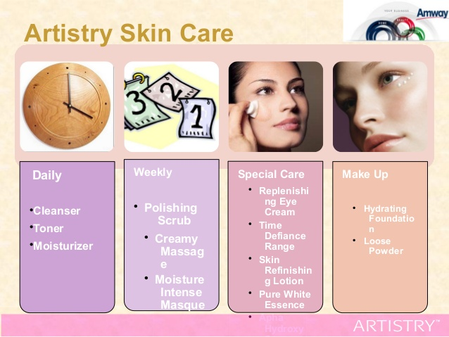

Slide 26





ARTISTRY – Cosmetics

Slide 27

ARTISTRY – Cosmetics

Slide 28
Artistry Cosmetics YouTube Videos
Artistry Signature Color Lipsticks
Learn about Artistry’s new Signature Lipsticks and the patented technological click and twist design.
www.youtube.com/watch?v=QKZHbZ9H0rc
All Day Natural Makeup Look Tutorial with Morgan Stewart | Artistry See how easy it is to create a natural makeup look using Artistry skincare and makeup. www.youtube.com/watch?v=jtcEjhDNaVY
Artistry Makeup Tutorial
A beautiful tutorial of applying Artistry makeup to the cover song: Ed Sheeran - Thinking Out Loud
www.youtube.com/watch?v=05hypxJWekk
Artistry Light Up Lip Gloss
– Open Box Presentation
www.youtube.com/watch?v=wMKibHlCfOY

Slide 29



Eco-Friendly Cleaning Products for the Home
Amway named 2017
Safer Choice Partner of the Year
www.youtube.com/watch?v=1fsKVBbDM_A

Slide 30
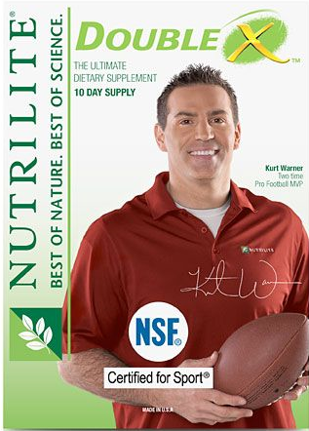


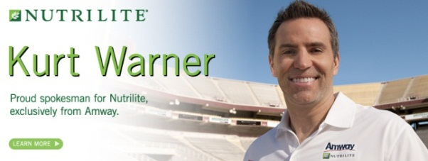
Fun Facts About Amway Since 2010
Between 2010-2015, ARTISTRY was the official skin care and cosmetics provider of the Miss America Pageant.
Between 2010-2015, former NFL Quarterback and Super Bowl MVP, Kurt Warner was a spokesperson for NUTRILITE and AMWAY.
In 2010, the Amway Center opened in downtown Orlando, Florida. It is a state-of-the-art, sports, entertainment and event facility. The building is home to the NBA team - the Orlando Magic.

Slide 31
THE OPPORTUNITY
The Company
Celebrating their 60th year in business
Registered with the Better Business Bureau
The Products
Top selling vitamins & supplements brand
High quality skin care & cosmetics brand
The Business
Approved by the Federal Trade Commission
Eco-friendly household cleaning supplies
NO inventory NO overhead NO large $$$ investment
Capitalizes on the top 3 business trends today
Make money by shopping and referring others

Slide 32
TOP BUSINESS TRENDS TODAY
This business just makes sense… it can’t get any easier!
Health & Beauty
With the Baby Boomers at or on the verge of retirement, the desire for staying fit and youthful is at an all time high.
Online Purchasing
With the ease and convenience of shopping online, more consumers are shifting their purchasing power to the internet.
Home-Based Businesses
With their financial security in doubt, many people are looking for other ways to generate income. (Income Diversification)

Slide 33
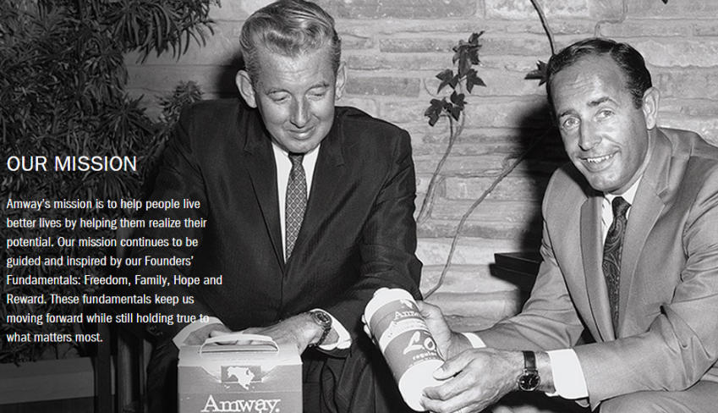
Amway YouTube Video
What is Amway?
www.youtube.com/watch?v=TGA8aW5tpKg

Slide 34
More About the Amway Company & Opportunity
Amway: Our Company
A business can do more than offer great brands and products. It can believe in people. Amway Co-Founders Jay Van Andel and Rich DeVos believed in people, in helping them live better lives by helping them realize their potential. www.youtube.com/watch?v=890k6BMcDKA
Amway: My Story - Independent Business Owners
The Amway opportunity is different. Whether you’re seeking extra income or more free time, with an Amway business you can start creating revenue on day one. Discover why the people who work for Amway see it as an opportunity to be successful and take more control over their life. www.youtube.com/watch?v=7UKqR_oAH7Y
Amway's Doug DeVos: Our focus on people is the Amway 'difference‘
Amway President Doug DeVos: “Amway is not about a business kit. Amway is not about a plan, even though the plan’s great. It’s not about products, even though the products are great. Amway is about people. This is a business about people helping people.”
www.youtube.com/watch?v=13gQXUaFV6Y
Visiting Amway World Headquarters | WHQ News
www.youtube.com/watch?v=qIMKglSHnzs
Amazing! AMWAY Global,
The BEST Opportunity in the World.
www.youtube.com/watch?v=OXlh8Lkxcek

Slide 35



Cofounder of Amway YouTube Videos
Richard DeVos’s Top 10 Rules For Success - "Everybody STARTS at the BOTTOM"
www.youtube.com/watch?v=7q3JLIFRjT0
President George W. Bush speaks
at Rich DeVos funeral www.youtube.com/watch?v=NITVp99C0MY

Slide 36
IS THIS OPPORTUNITY FOR YOU?
If you answer “YES” to many of the questions below, then this business might just be the perfect fit for you. Contact me today for more information.
Are you concerned about your financial future?
Do your expenses EXCEED your income?
Would you like to save more towards your retirement?
Do you like trying new things, meeting new people, and helping others?
Is eating healthy and staying active important to you?
Have you ever purchased anything online?
Do you know people who have purchased items online?
Do you think the popularity of online purchasing is a trend that will continue?
Have you ever thought about starting your own business?
Do you like the idea of being your own boss, controlling when and where you work, and how much money you make?

Slide 37

Contact Information
Johnny D’s Health Zone Plus
“The Healthy Choice for Healthy Lifestyles”
John K. Doherty
Independent Business Owner
Fort Myers, Florida
239-770-6847
Jdoherty239@aol.com
Websites:
Business/Informational - www.healthzoneplus.com
Online Store - www.amway.com/jkdohertyhealthzone

